Slide 1


2026
HURRICANE
TASK FORCE
May 13, 2026

Slide 2
ACKNOWLEDGMENTS
Thank you to HTF members !!!
Neighbors
Mayor & City Commission
Resolution 2026-09

Slide 3
HTF RESOLUTION 26-09
Assess current hurricane preparedness
ID vulnerabilities, improvements to emerg planning, infrastructure, public communic
Recommend enhanced community resilience
Intergov’t coordination on best practices for disaster preparedness and response

Slide 4
HURRICANES
June 1 to November 30
Part of Paradise Living
August – September
S-10, A-13, A-24, S-26, S-28
https://www.aoml.noaa.gov/hrd/hurdat/All_U.S._Hurricanes.html

Slide 5
PREPARATION, RESPONSE, RECOVERY
Public Safety – protect life
Infrastructure – protect property
Communications – as much as possible
Re-Establish Daily Life

Slide 6
COORDINATION
Government – city, county, state, federal
Non-government – social, faith, community
Private – equipment, services, expertise

Slide 7
Gov’t Coordination
City of IRB
Pinellas County Emergency Mgt
Florida Division of Emergency Mgt
Federal Emergency Mgt Agency

Slide 8
CITY Coordination
Preparations
Communication
Coordinate with all others
Restore City Services

Slide 9

PCEM Coordination
Updates
EOC-Incident Commander
Evacuation and Return
Resources – equipment, supplies
Preparation – Ready Pinellas
https://pinellas.gov/department/emergency-management/

Slide 10

PCEM COORDINATION
After-Action Report
After-Action Overview
Debris Removal
Permitting

Slide 11

FDEM Coordination
Disaster preparedness
Recovery-Response, equipment/supply
Funding (pass through for gov’t)
Mitigation – elevate Florida

Slide 12

FEMA Coordination
Individual Assistance
Public Assistance
Regulatory Compliance (state, city)
NFIP
Mitigation – various grants

Slide 13
OPEN DISCUSSION
What worked
What did not work
Improvement actions
NEXT STEPS, ACTIONS, MEETINGS

Slide 14
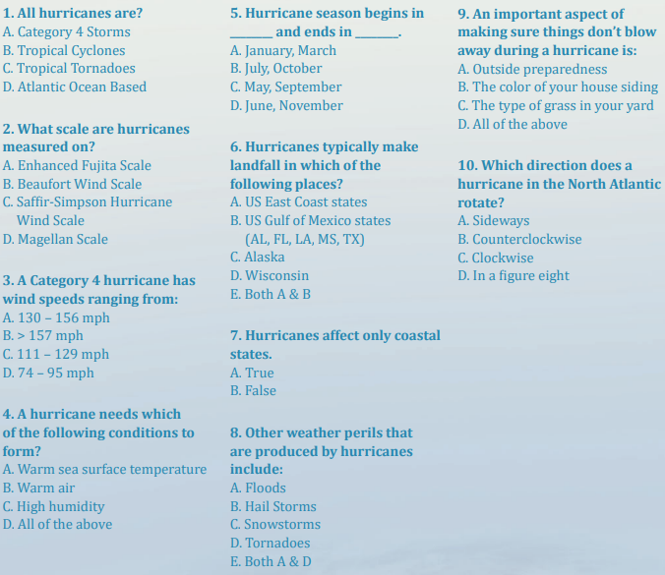
HURRICANE QUIZ
Flash.org/hurricanestrong

Slide 15
Thank you !
Ryan Henderson, City Manager
rhenderson@irbcity.com
727.595.2517
Robin Gomez, Administrative Director
rgomez@irbcity.com
727.214.7463
Dean Scharmen, Public Works Director
dscharmen@irbcity.com
727.580.0713

